Slide 1
Misoperations Reduction Strategy
James Hanson, WECC
Randy Spacek, Avista
Jonathan Meyer, Idaho Power
Chris Fleenor, Tucson Electric Power

Slide 2

Dream Team Needed

Slide 3
Advisory Group Created
Randy Spacek – Avista Corp.
Jonathan Meyer – Idaho Power Company
Chris Fleenor – Tucson Electric Power
David Sydor – BC Hydro
Holly Mitchell – Northwestern Corp.
Rich Bauer – NERC
Jeff Mitchell – Reliability First

Slide 4

Ground Rules

Slide 5

Inward Focus

Slide 6
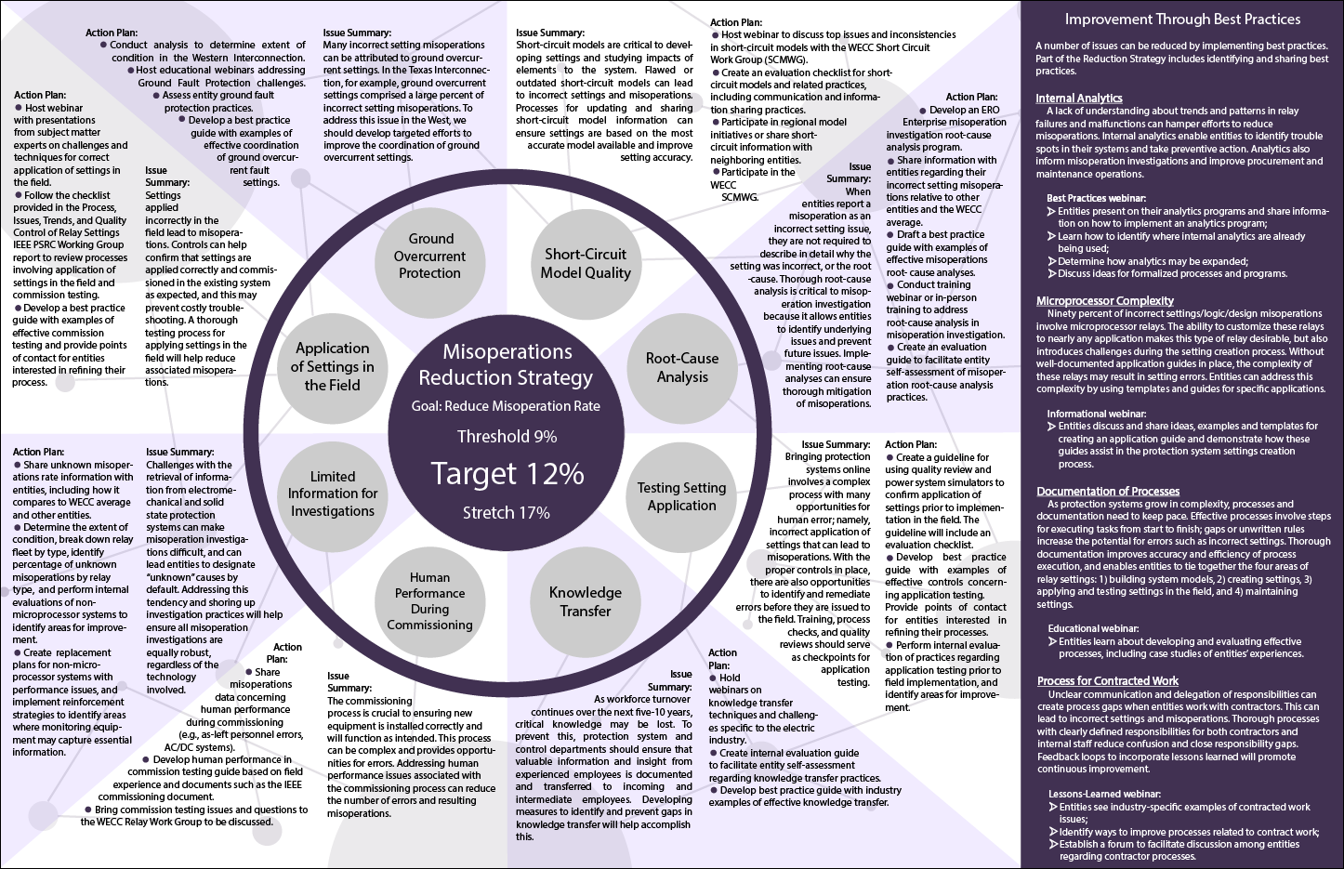
Handout

Slide 7
Issue Summaries and Action Plans

Slide 8
Improvement Through Best Practices

Slide 9
Short-Circuit Model Quality
Issue Summary
Action Plan
Short-circuit models are critical to developing settings and studying impacts of elements to the system. Flawed or outdated short-circuit models can lead to incorrect settings and misoperations.
Processes for updating and sharing short-circuit model information can ensure settings are based on the most accurate model available and improve setting accuracy.
Host webinar to discuss top issues and inconsistencies in short-circuit models with the WECC Short Circuit Work Group (SCMWG).
Create an evaluation checklist for short- circuit models and related practices, including communication and information sharing practices.
Participate in regional model initiatives or share short- circuit information with neighboring entities.
Participate in the WECC SCMWG.

Slide 10
Root-Cause Analysis
Issue Summary
Action Plan
When entities report a misoperation as an incorrect setting issue, they are not required to describe in detail why the setting was incorrect, or the root-cause. Thorough root-cause analysis is critical to misoperation investigation because it allows entities to identify underlying issues and prevent future issues. Implementing root-cause analyses can ensure thorough mitigation of misoperations.
Develop an ERO Enterprise misoperation investigation root-cause analysis program.
Share information with entities regarding their incorrect setting misoperations relative to other entities and the WECC average.
Draft a best practice guide with examples of effective misoperations root- cause analyses.
Conduct training webinar or in-person training to address root-cause analysis in misoperation investigation.
Create an evaluation guide to facilitate entity self-assessment of misoperation root-cause analysis practices.

Slide 11
Testing Setting Application
Issue Summary
Action Plan
Bringing protection systems online involves a complex process with many opportunities for human error; namely, incorrect application of settings that can lead to misoperations. With the proper controls in place, there are also opportunities to identify and remediate errors before they are issued to the field. Training, process checks, and quality reviews should serve as checkpoints for application testing.
Create a guideline for using quality review and power system simulators to confirm application of settings prior to implementation in the field. The guideline will include an evaluation checklist.
Develop best practice guide with examples of effective controls concerning application testing.
Provide points of contact for entities interested in refining their processes.
Perform internal evaluation of practices regarding application testing prior to field implementation, and identify areas for improvement.

Slide 12
Knowledge Transfer
Issue Summary
Action Plan
As workforce turnover continues over the next five-10 years, critical knowledge may be lost. To prevent this, protection system and control departments should ensure that valuable information and insight from experienced employees is documented and transferred to incoming and intermediate employees. Developing measures to identify and prevent gaps in knowledge transfer will help accomplish this.
Hold webinars on knowledge transfer techniques and challenges specific to the electric industry.
Create internal evaluation guide to facilitate entity self-assessment regarding knowledge transfer practices.
Develop best practice guide with industry examples of effective knowledge transfer.

Slide 13
Human Performance During Commissioning
Issue Summary
Action Plan
The commissioning process is crucial to ensuring new equipment is installed correctly and will function as intended. This process can be complex and provides opportunities for errors. Addressing human performance issues associated with the commissioning process can reduce the number of errors and resulting misoperations.
Share misoperations data concerning human performance during commissioning (e.g., as-left personnel errors, AC/DC systems).
Develop human performance in commission testing guide based on field experience and documents such as the IEEE commissioning document.
Bring commission testing issues and questions to the WECC Relay Work Group to be discussed.

Slide 14
Limited Information for Investigations
Issue Summary
Action Plan
Challenges with the retrieval of information from electromechanical and solid state protection systems can make misoperation investigations difficult, and can lead entities to designate “unknown” causes by default. Addressing this tendency and shoring up investigation practices will help ensure all misoperation investigations are equally robust, regardless of the technology involved.
Share unknown misoperations rate information with entities, including how it compares to WECC average and other entities.
Determine the extent of condition, break down relay fleet by type, identify percentage of unknown misoperations by relay type, and perform internal evaluations of non-microprocessor systems to identify areas for improvement.
Create replacement plans for non-microprocessor systems with performance issues, and implement reinforcement strategies to identify areas where monitoring equipment may capture essential information.

Slide 15
Application of Settings in the Field
Issue Summary
Action Plan
Settings applied incorrectly in the field lead to misoperations. Controls can help confirm that settings are applied correctly and commissioned in the existing system as expected, and this may prevent costly troubleshooting. A thorough testing process for applying settings in the field will help reduce associated misoperations.
Host webinar with presentations from subject matter experts on challenges and techniques for correct application of settings in the field.
Follow the checklist provided in the Process, Issues, Trends, and Quality Control of Relay Settings IEEE PSRC Working Group report to review processes involving application of settings in the field and commission testing.
Develop a best practice guide with examples of effective commission testing and provide points of contact for entities interested in refining their process.

Slide 16
Ground Overcurrent Protection
Issue Summary
Action Plan
Many incorrect setting misoperations can be attributed to ground overcurrent settings. In the Texas Interconnection, for example, ground overcurrent settings comprised a large percent of incorrect setting misoperations. To address this issue in the West, we should develop targeted efforts to improve the coordination of ground overcurrent settings.
Conduct analysis to determine extent of condition in the Western Interconnection.
Host educational webinars addressing Ground Fault Protection challenges.
Assess entity ground fault protection practices.
Develop a best practice guide with examples of effective coordination of ground overcurrent fault settings.

Slide 17
Improvement Through Best Practices
Internal Analytics
  Best Practices webinar
Microprocessor Complexity
  Informational webinar
Documentation of Processes
  Education webinar
Process for Contracted Work
  Lessons-Learned webinar

Slide 18
August 30, 2017 Reduction Strategy Discussion
What about misoperations keeps you up at night?
What can we do about it?
Does the Reduction Strategy set us in the right direction?

Slide 19
Reduction Strategy Comment Period
Reduction Strategy document will be available for content review September 1-October 15 at:
https://www.wecc.biz/PerformanceAnalysis/

